Slide 1
California Polytechnic State University San Luis Obispo
AgBot Challenge 2018

Slide 2
Initial Solution
Autonomous John Deere 5525N
Tow behind watermelon harvester (not built)
Achieved remote control and GPS tracking
Issues:
Too heavy to ship economically from CA
Classes are still going on, no time to drive

Slide 3
Final Solution
Fully electric autonomous golf cart/harvester
Increases reliability, less moving parts
Decreases operational cost
Environmentally conscious
Potential for solar recharge
Detection techniques
Camera Vision ripeness and direction detection (Active)
Load Cell and Volume detection for density (Not Implemented)

Slide 4
Autonomous Control
GPS
Used to guide bot to active harvest field or active solar charging spot
TopCon GPS Reciever
Camera Vision
Used to finely control direction to watermelon in question

Slide 5
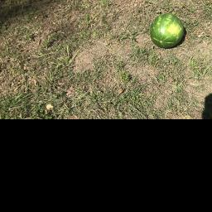

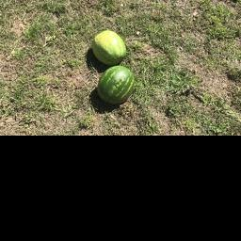

Detection Techniques
Camera Vision: Raw vs. Filtered Examples

Slide 6
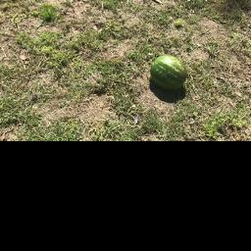

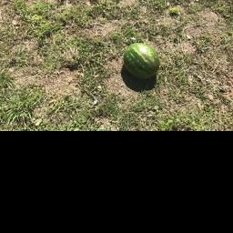

Detection Techniques
Camera Vision: Raw vs. Filtered Examples

Slide 7
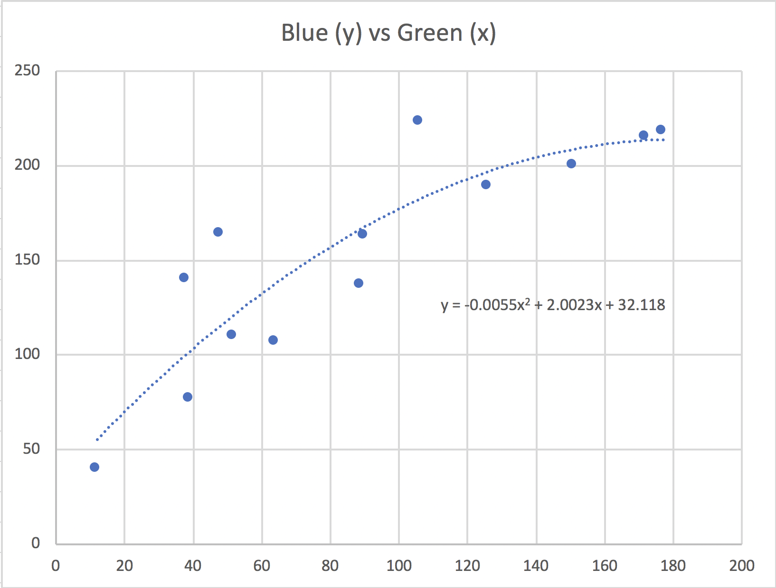
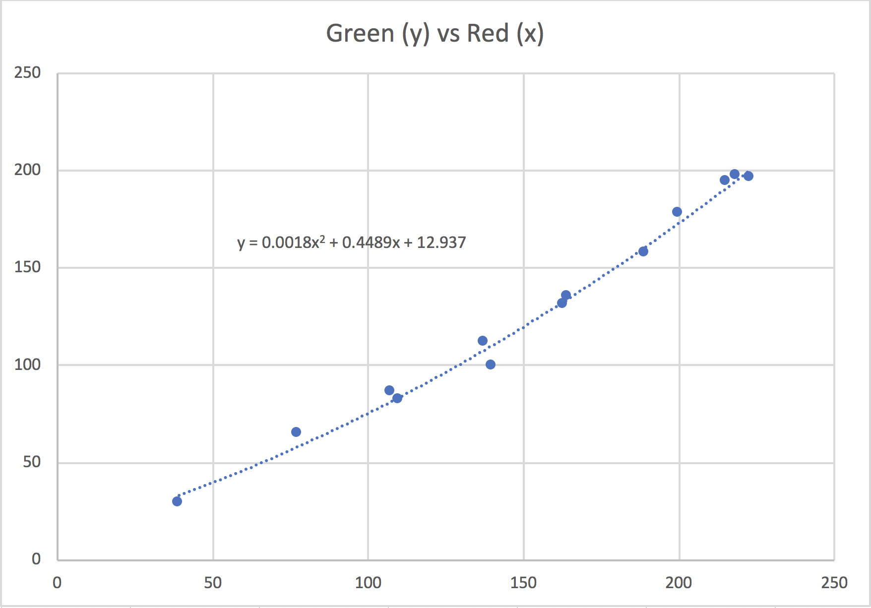
Pixel Relationships

Slide 8
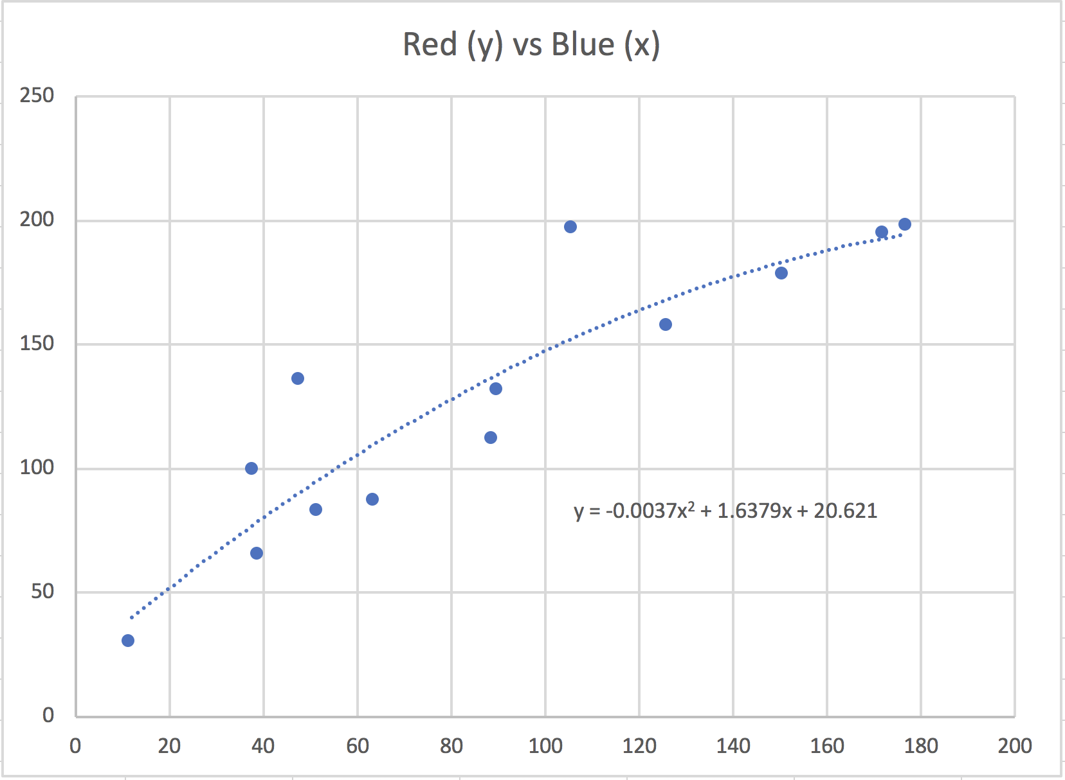
Pixel Relationships

Slide 9
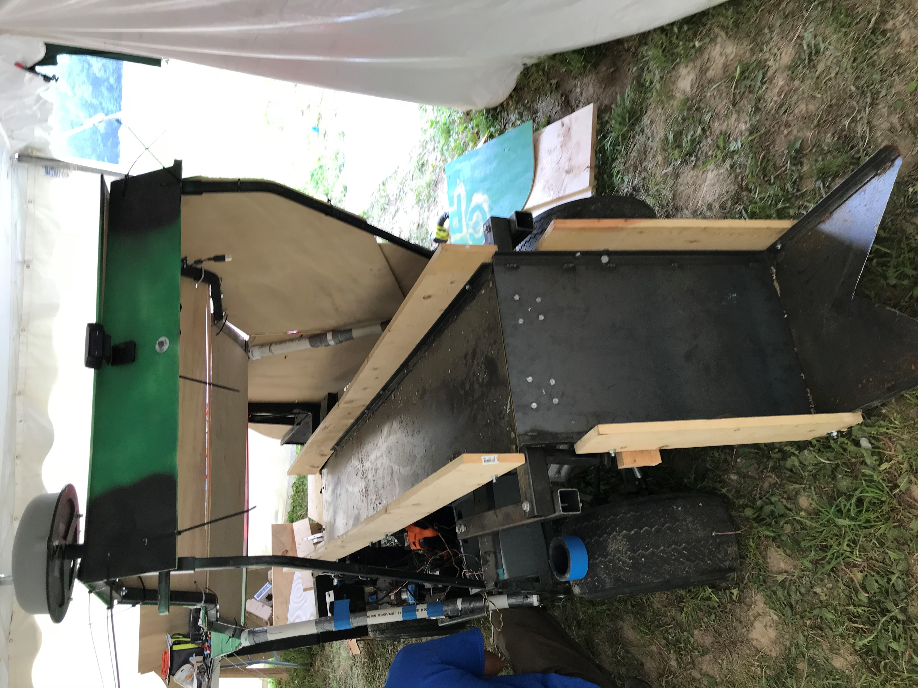
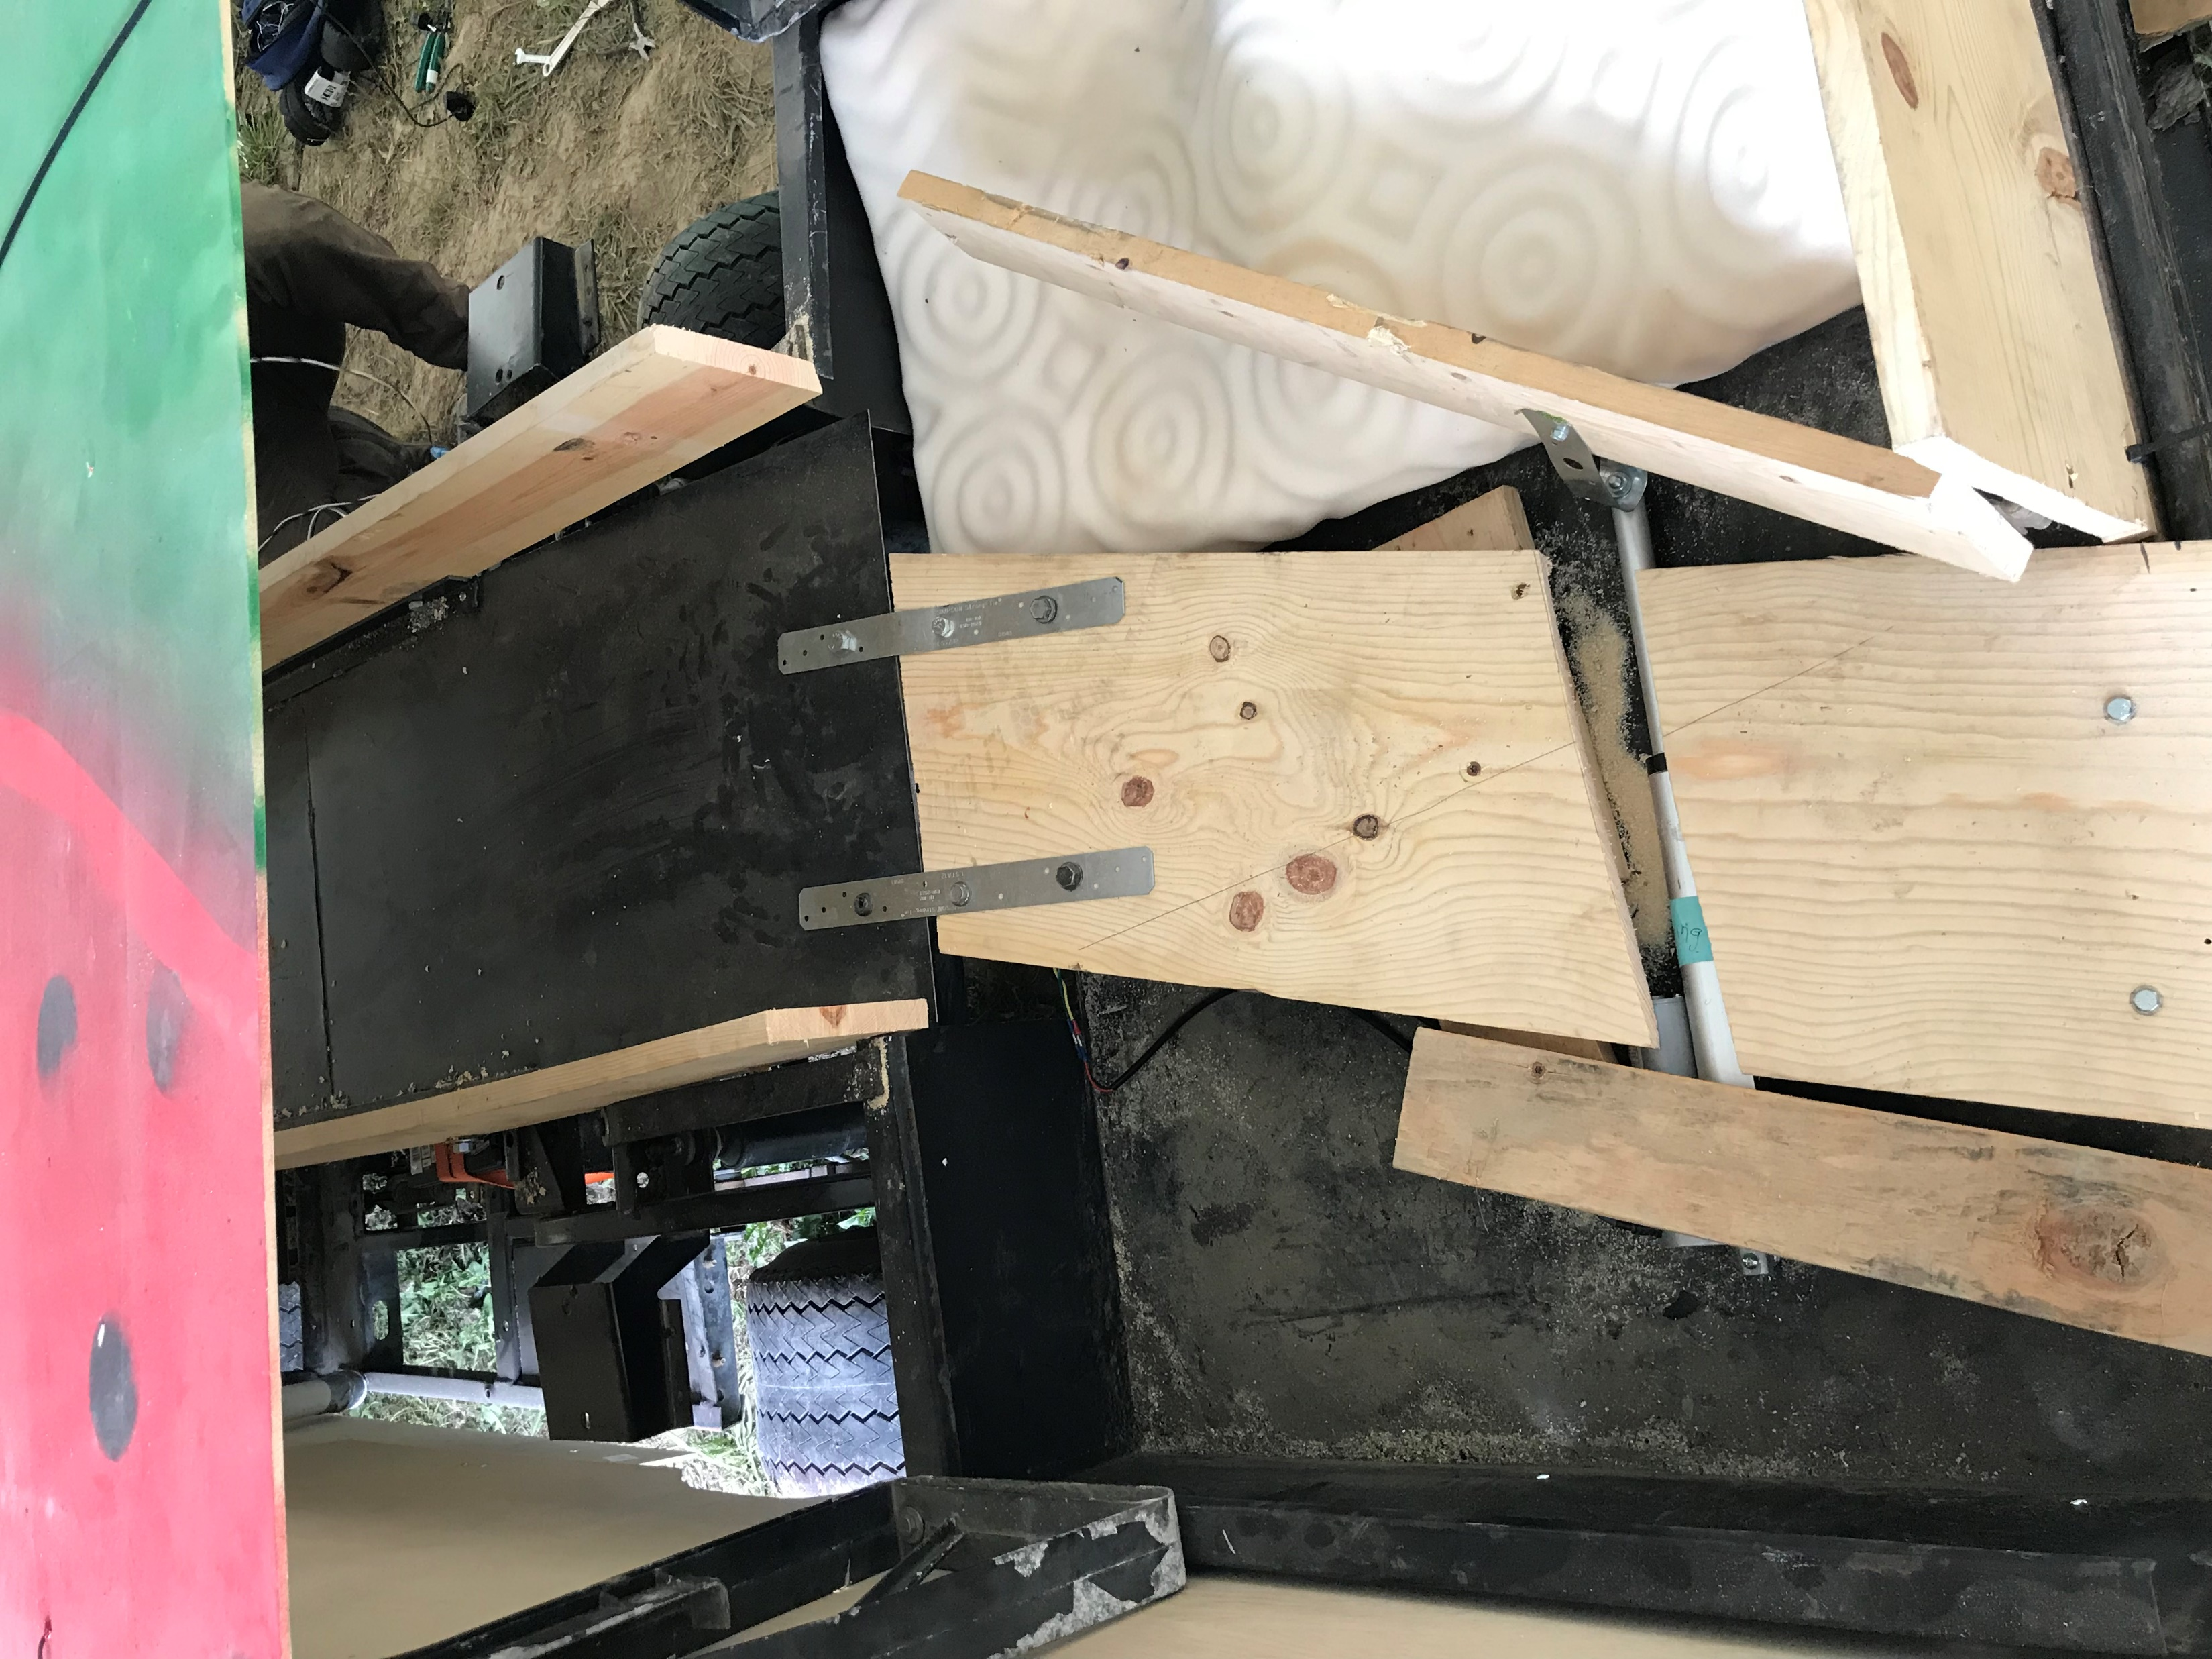
System Summary

Slide 10
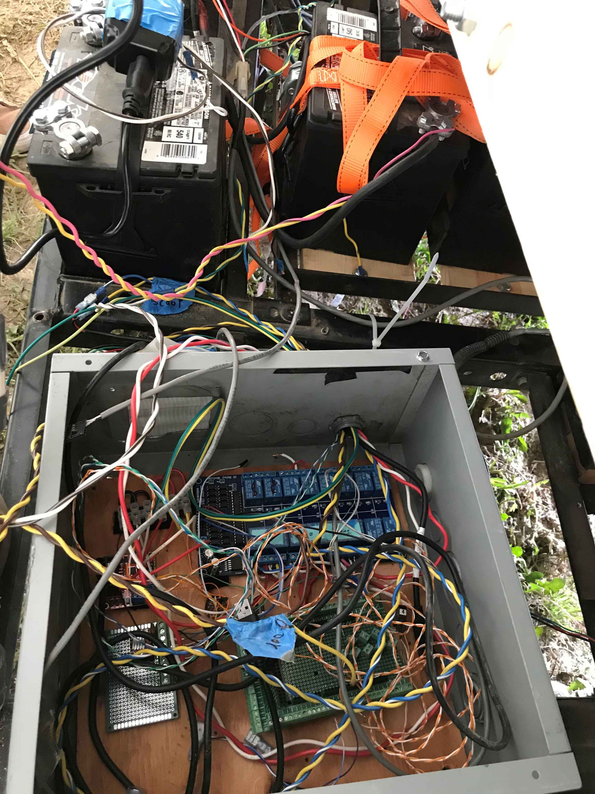
Summary

Slide 11
Sponsors
Valley Packline Solutions
Glad-A-Way
Topcon

